Slide 1
SQL database security
5th September 2019

Slide 2
Last week
We reviewed how to work with SQL
We experimented with processing SQL queries programmatically using PHP
We experimented with a sample employees database
Today
SQL security issues
Access control
Injection attacks
LAMP project specs

Slide 3
SQL security
The database is the critical vulnerability in your web service
Lower elements in the stack (OS, server) are managed by large organizations
Higher elements in the stack are static webpages which can’t be compromised
Wrong!
We will see XSS attacks later in this course
First rule of database security
Make sure your SQL server is password protected
Does mysql –u root work for you?

Slide 4
Access privileges in SQL
Root account has all privileges
Other accounts should be granted privileges selectively
Three types of privileges
Admin
Database
Object
Use SHOW GRANTS to see which accounts have which privileges on your SQL server
Grant privileges defensively

Slide 5
Who should have these privileges?
ALL
ALTER *
CREATE
DROP
EVENT
FILE *
INSERT
SELECT
SHOW DATABASES

Slide 6
How to grant privileges
Can grant privileges to individual user accounts
Make users with CREATE USER <user_name@sqlserver_addr> statement
See their current access privileges with
SHOW GRANTS FOR user_name
Grant privileges with
GRANT <permissions> [ON <table>] TO <user> [WITH GRANT OPTION]
Revoke privileges with
REVOKE <permissions> [ON <table>] FROM <user>
Can also copy privileges from one user account to another

Slide 7
How to grant privileges
Generally better to
Create Roles
Assign multiple user accounts to each role
Make roles with CREATE ROLE <role_name> statement
See their current access privileges with
SHOW GRANTS FOR role_name
Grant privileges with
GRANT <permissions> [ON <table>] TO <role> [WITH GRANT OPTION]
Revoke privileges with
REVOKE <permissions> [ON <table>] FROM <role>
Users can be assigned to roles with
GRANT role TO user
To see the privileges of a user in a role
SHOW GRANTS FOR user USING role

Slide 8
Sample application
Library management system
Database contains records for
Book list
Student list
Borrow dates
Return dates
Reservation queue
What roles should we create for this database?
What tables should we use for this database?
What privileges should be granted to each role?

Slide 9
Network security
Basics
Put the server behind a firewall
Block port to external access
Transmit data using SSL/SSH
Sanitize data inputs
Prevent SQL injection attacks

Slide 10
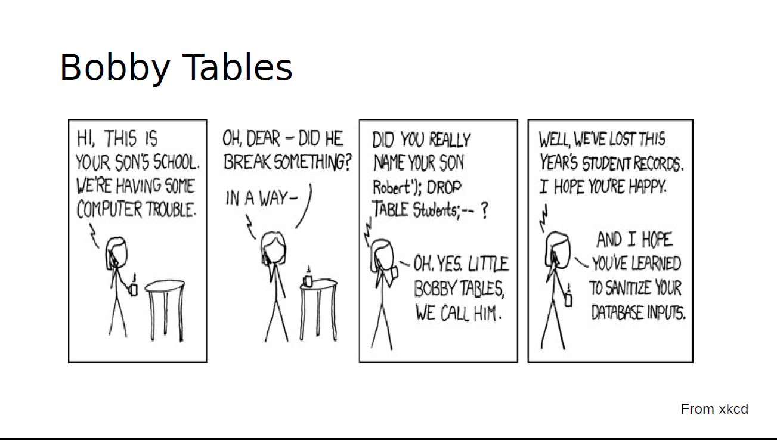

Slide 11
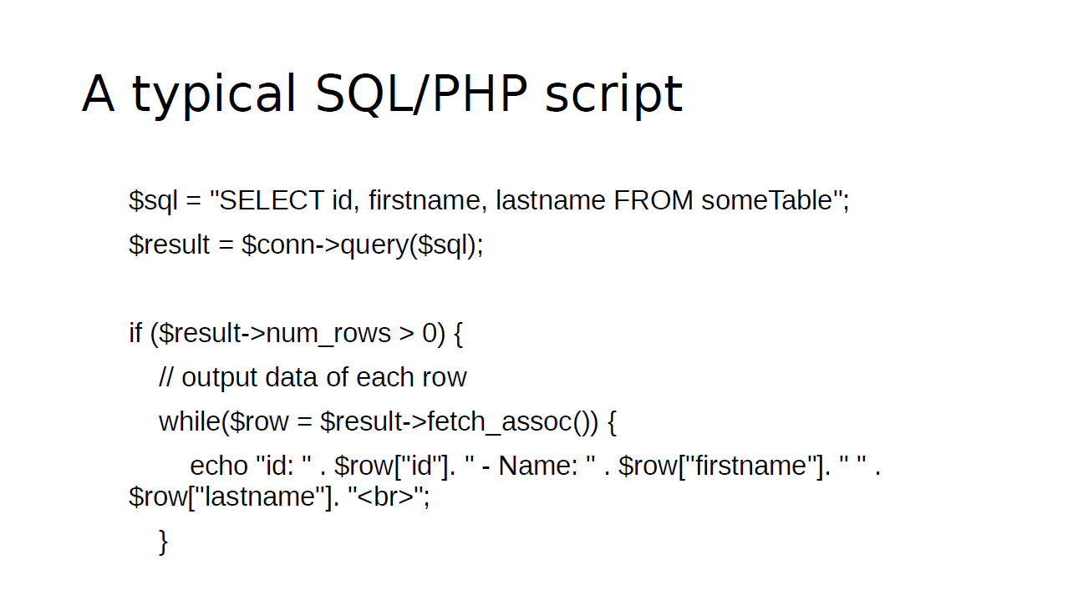

Slide 12
An SQL injection attack
Normal SQL query
SELECT * FROM Students WHERE Name = ‘Bobby Tables’;
Wrapped as PHP variable
$sql = “SELECT * FROM Students WHERE Name = ‘Bobby Tables’;”
In general
$sql = “SELECT * FROM Students WHERE Name = <user_input>;”

Slide 13
SQL injection attack
Pass in user input that makes the $sql variable read
$sql = “SELECT * FROM Students WHERE Name = ‘Bobby Tables’; DROP TABLE Students; -- ”
Consequences
Moral of the story
Letting users pass in whatever inputs they want is a bad idea

Slide 14
Prevention
Escaping special characters
Make a list of special characters
Escape (prepend with \) them by parsing user inputs
Prepared statements
Modern scripting languages allow the use of prepared statements with placeholders for user inputs
Placeholders are typed and don’t allow arbitrary string inputs
See a PHP example here

Slide 15
In lab next week
Develop your own LAMP application
Specifications
Should read, and write to a mysql database and display output to a web interface
Have to pre populate database from some source
Database must have at least 100 records
Application must have at least three roles, with appropriate access control:
Admin, dev, user
All users must access application via a username and password
Password should be stored in encrypted form
All data inputs should be sanitized

Slide 16
Grading policy
Should show me your demo by end of September
No rush, showing me later does not automatically deduct points
Fulfilling all specifications gets you 80 points
I reserve 20 points to assign at my own discretion
I’m looking for cleanness of code, of interface, and of thought process

